Slide 1


Quantum Ledger Technology (QLT)
Next Gen paradigm to combat cyber attacks on crypto assets
A novel client-server cybersecurity framework deployed using Solid State System on a Chip (3SoC) powered by Zero Vulnerability Computing (ZVC) technology to deliver a Quantum resistant security to Blockchain/DLT infrastructure.
Quantum Ledger Technology LTD, UK

Slide 2

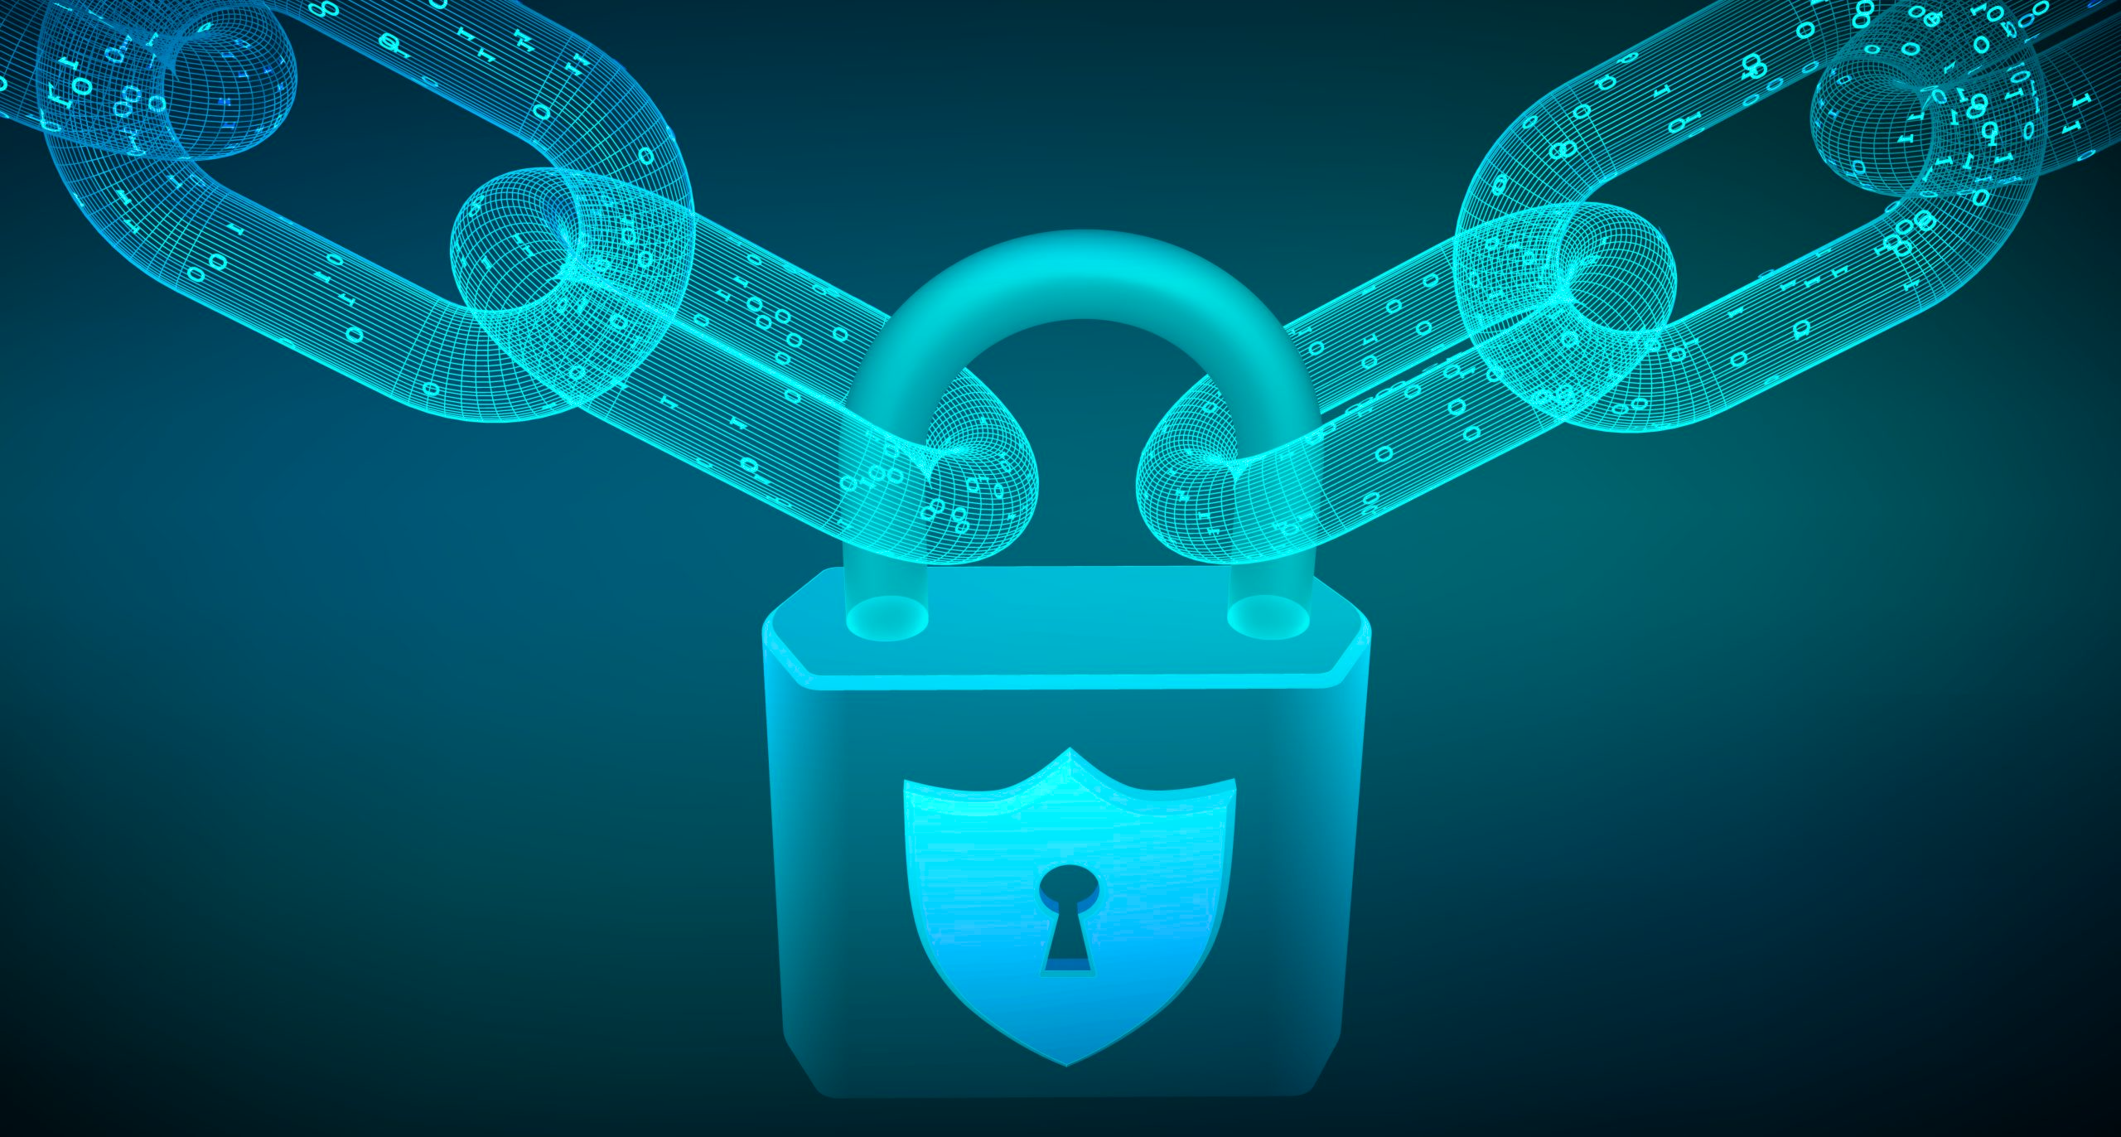
Overview
#1
Blockchain/DLT is projected to be a $3 trillion industry by 2030.
#2
A billion users trade more than 20,000 crypto assets over 380 crypto exchanges & 245 NFT marketplaces
#3
A record $14 billion in crypto was lost in 2021
#4
Cryptocurrency theft increased 516% from 2020
Securing Blockchain/DLT infrastructure is a major concern as billions are lost to hackers every year

Slide 3
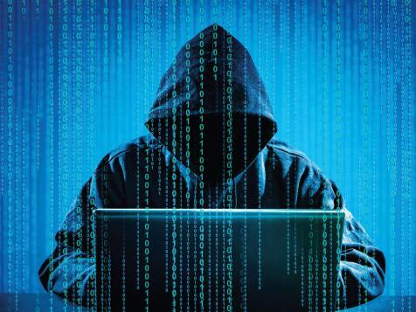
Problem
Almost all of the blockchain (BC)/crypto hacks can be attributed to any one of the following threats
#1
Client End Vulnerabilities
Assets lost due to client-end system vulnerabilities
#2
Exchange End Vulnerabilities
Assets lost while using CEX & DEX for crypto transactions
#3
Threat from Quantum Computers (QC)
Risk that QC will break the current PKI ecosystem of BC/DLT
Scams/Hacks prove detrimental to the growth of the blockchain/crypto economy and hence cybersecurity remains the top priority for the industry

Slide 4
Reasons for Blockchain/DLT Vulnerabilities
Security breaches in legacy DLT/blockchain systems can be summarized into 2 major categories
#1
Hacks due to 3rd Party Permissions
Inherent vulnerabilities originating from mandatory 3rd party permissions granted by legacy hardware/software to 3rd party codes/apps.
#2
Q-Day Threats
Impending threats from future quantum computers that can potentially break the current PKI infrastructure of blockchain.
Unfortunately, the current BC/DLT ecosystem is vulnerable to both and is prone to complete breakdown

Slide 5
More Problems
To protect the Internet from Quantum threats NIST initiated PQC (Post Quantum Cryptography) standardization process in 2017.
#1
2017: 82 candidate PQCs
In 2017 82 candidate PQCs entered the NIST challenge
#2
2022: Four Finalist PQCs selected
Two of the four finalists were broken the same year
#3
2023: All NIST selected PQCs were breached
All 82 PQC candidates, having failed NIST initiative in serious jeopardy
Six years PQC standardization process having failed Q-Day threat from Quantum Computers looms large

Slide 6
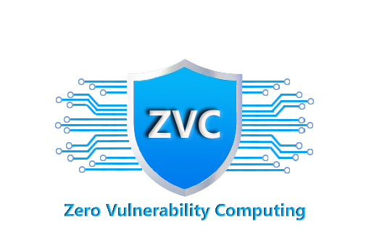




Solution: Quantum Ledger Technology (QLT)
Deploys award-winning Zero Vulnerability Computing (ZVC) cybersecurity framework.
ZVC bans all the 3rd party permissions and is encryption agnostic, thus QC resistant.
ZVC merges all legacy software layers to build Solid-State Software on a Chip (3SoC).
3SoC can be deployed as a client-server network (Intranet) with zero attack surface.
Segregates the DLT framework from mainstream Internet rendering it inaccessible to legacy devices.
3SoC is robust, light, cost & energy efficient & future ready, ideal for securing any DLT
01
02
03
TESTED & VALIDATED
SUPPORTED
PUBLISHED
by IMEC Labs, Belgium
by 35+ EU Partners
in Future Internet
Notes:
https://www.freepik.com/free-psd/laptop-mock-up-isolated_4075244.htm#page=1&query=MACBOOK%20MOCKUP&position=3
https://www.freepik.com/free-photo/female-scientist-white_4103194.htm#page=1&query=cyber%20security&position=1

Slide 7
Traction: Where we are now?
30+
30+
6
European Partners
Countries
European Cybersecurity Centers of Excellence
5
4
Seal of Excellence
Peer-reviewed Publications
Pending Patents
European Union
Notes:
https://www.freepik.com/free-psd/laptop-mock-up-isolated_4075244.htm#page=1&query=MACBOOK%20MOCKUP&position=3
https://www.freepik.com/free-photo/female-scientist-white_4103194.htm#page=1&query=cyber%20security&position=1

Slide 8

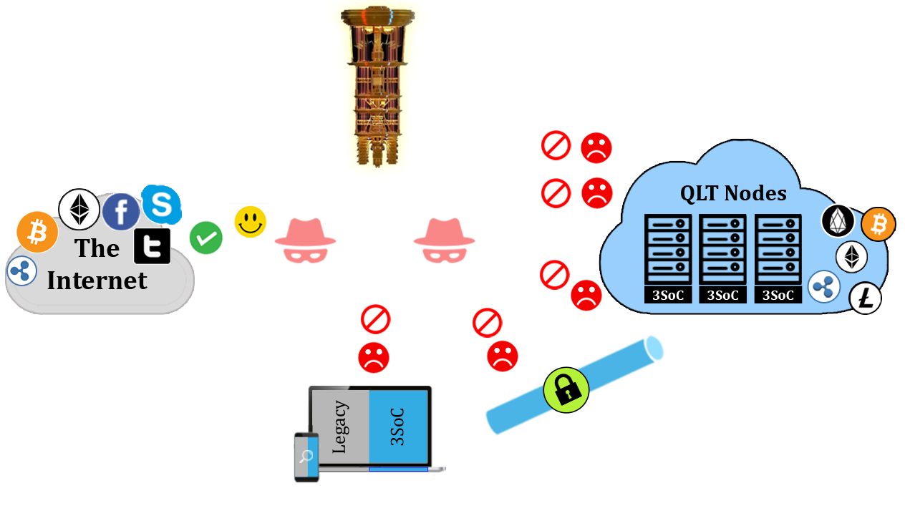
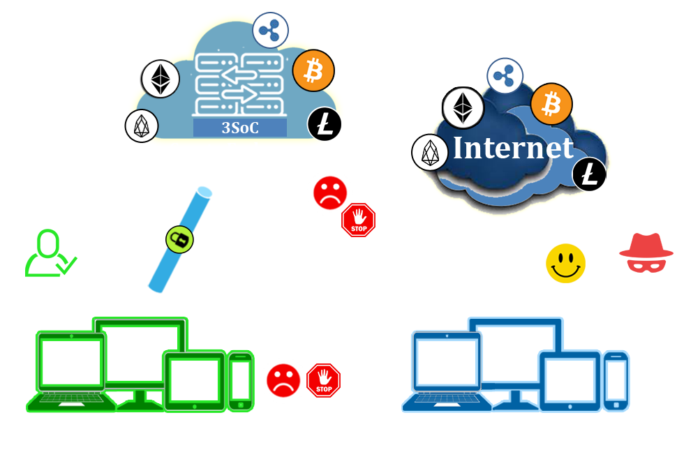
QLT Architecture
Segregates DLT infrastructure from legacy internet forming an intranet (Fig.1).
Can be used for securing Crypto Exchange infrastructure (Fig.2)
Users are provided with a switchable 3SoC drive (Fig.1)
End-user device connects to the DLT/ Exchange node installed on the 3SoC server, creating a secure 3SoC tunnel (Fig. 1& 2)
3SoC server designed to exclusively accept authentication requests from a 3SoC client device.
All other requests from unauthorized peers or hackers with legacy computing devices are declined.
Users can switch over the client device from the legacy Internet mode to the QLT Intranet mode
Fig.1 QLT Framework for BC Node
Fig.2 QLT Framework for Crypto Exchange

Slide 9
Market Size (Blockchain Tech Market)
$267M net present value (NPV)
based on a conservative 1% penetration of serviceable available market (SAM) in 5 years
TAM
100%
$245B*
Global Blockchain Market considered as TAM
SAM
39%
$95.7B*
Blockchain DeFi Market considered as SAM
SOM
1%
$957M
QLT’s share of SAM in 5 Years
*Base year 2027 based on PrecedenceResearch.com report

Slide 10




Business Model
3SoC Server Deployment
B2B Associations with Blockchain Protocols & Crypto Exchanges
QLT /3SoC Client Device Hardware wallet sales to crypto users QLT ICO Campaign to boost the economy
HYBRID
B2B
B2C
Crypto Community
Pre-orders via crowdfunding campaign QLT Token sales to build community
Blockchain Infrastructure
Hosting Blockchain Nodes/ Exchanges over 3SoC servers
Notes:
https://www.freepik.com/free-photo/profile-portrait-young-woman-hand-her-forehead_1281231.htm#page=1&query=ERROR&position=23

Slide 11

Business Strategy
03
Growth Strategy
Direct B2C sales to the DeFi community members & B2B associations with DeFi companies & crypto exchanges
02
Customer Acquisition
QLT ICO campaign to build DeFi community
01
Market Entry
Crowdfunding campaign on Kickstarters to gather support from early adopters
Notes:
https://www.freepik.com/free-photo/profile-portrait-young-woman-hand-her-forehead_1281231.htm#page=1&query=ERROR&position=23

Slide 12
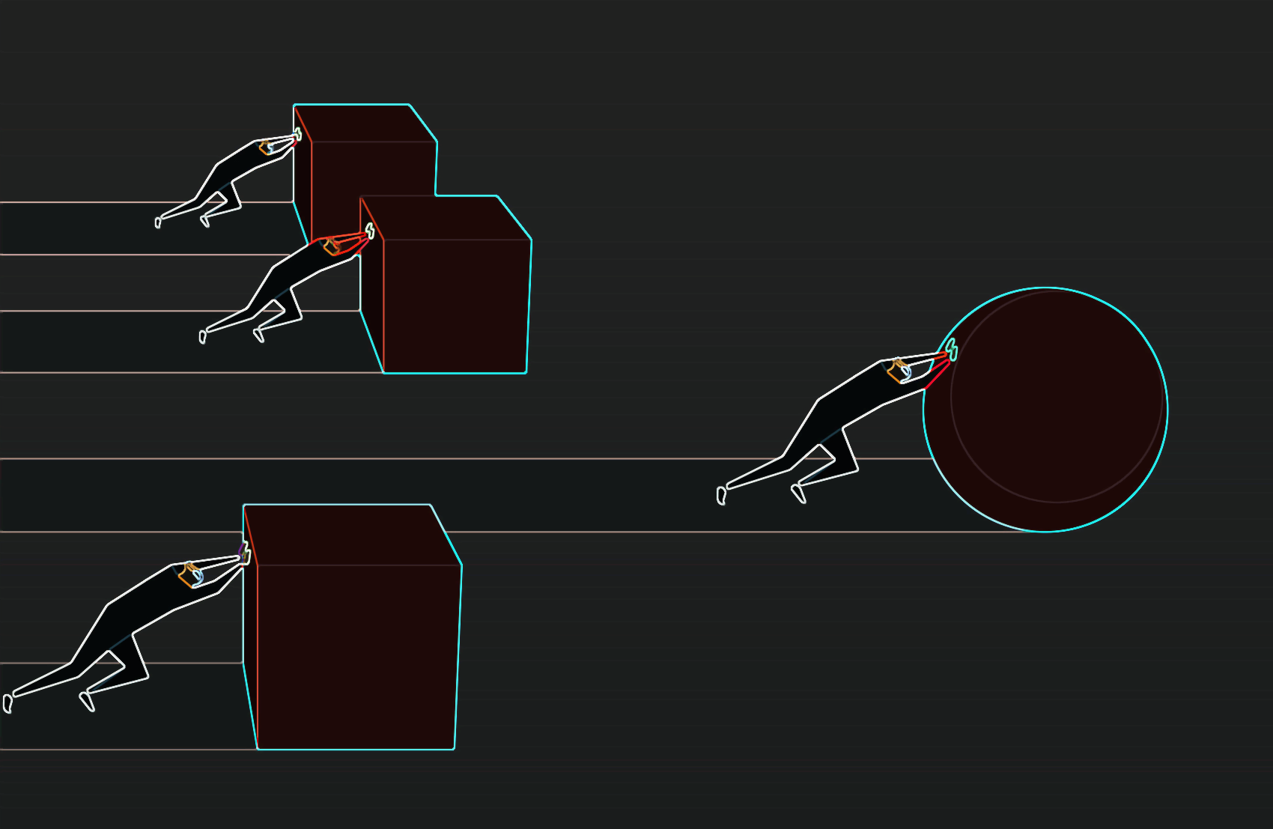
Competitive Edge
#1
Encryption-Agnostic Cybersecurity Solution
All the potential PQC solutions claiming Q-Day security have so far failed. Even if any succeeds PQC is resource-intensive and very expensive
#2
QLT is Blockchain/DLT Agnostic
QLT can be deployed to secure any BC/DLT network or any NFT or crypto exchange infrastructure
#3
Holistic Solution for all cybersecurity breaches
QLT protects the blockchain infrastructure/ exchanges against impending threat from Quantum Computers as well as against conventional vulnerabilities.
#4
Pricing & Value for Money: Lowest Price, Highest Value
Easy deployment with minimal changes in current infrastructure and no extravagant costings of deploying costly PQC methods, delivers great value for money
#5
IP Protected With Six Pending Patents & Seventh in Preparation
Freedom to Operate (FTO) Report available on request
Notes:
https://www.flaticon.com/free-icon/spam_927958?term=EMAIL%20SPAM&page=1&position=46

Slide 13
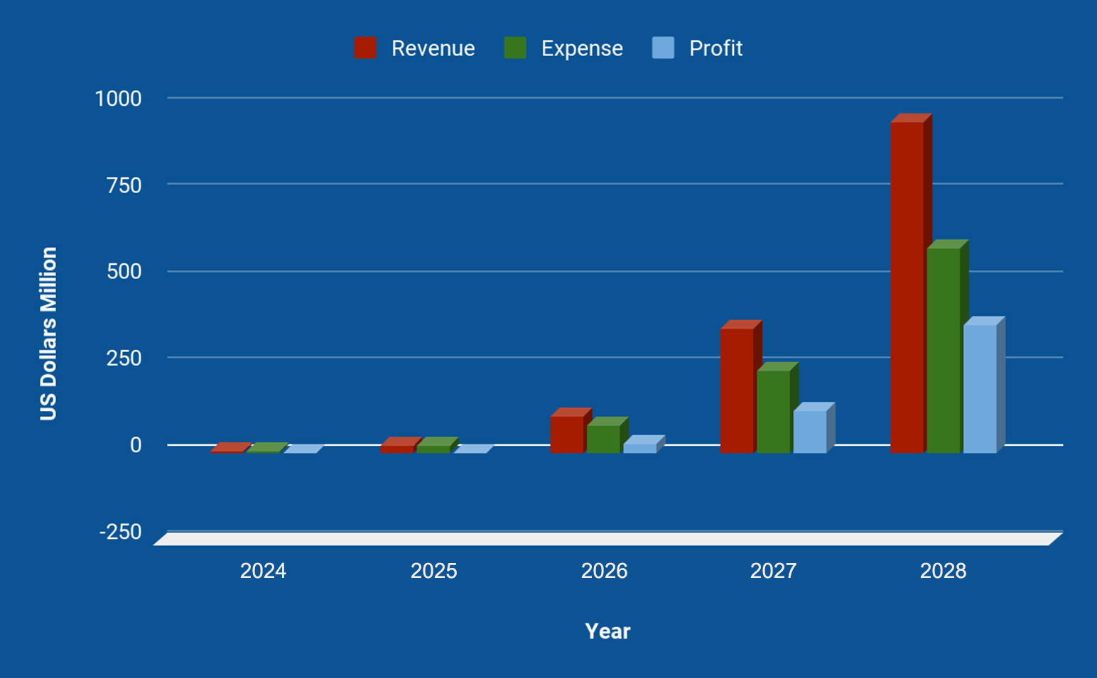
5-Year Projections
Notes:
https://www.flaticon.com/free-icon/spam_927958?term=EMAIL%20SPAM&page=1&position=46

Slide 14



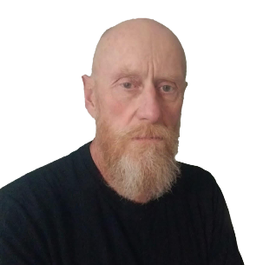
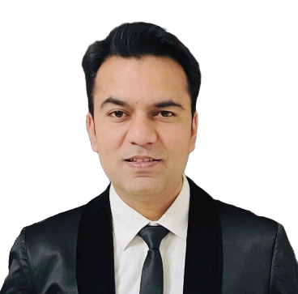


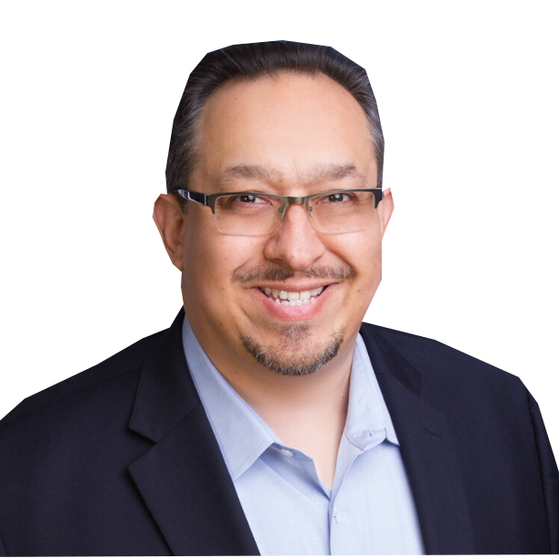


Team: 132+ years of combined experience
DAVID BELL
FAZAL RAHEMAN Inventor, ZVC
MICHAEL SCHUETTE
CTO
ASAD KHAN
Head, Business Dev
CEO
Corporate strategist, crypto investor, expert in building and managing crypto networks, adroit in offering executive oversight
Research scientist, innovator, philanthropist, visionary and serial inventor with over 34 global patents.
Research Scientist, Expert in NAND Flash Memory and Solid State drive technology with over 53 Patents in the same field
Dynamic and result driven professional with over 15 years of experience in sales, marketing and relationship management in B2C, B2B for corporate & government
DANIELLE BELL
Head, Social Media
TEJAS BHAGAT
Head, Project
ANGEL ORRANTIA
CFO, General Counsel
CASI BORG
Virtual Spokesperson
Expert in analyzing engagement data, creating content, identifying trends in interactions, planning and executing digital campaigns for online communities
Cofounder, EU Grant writer, blockchain enthusiast, architect of deep tech ecosystems, program lead for lab-to-market value creation
Decades of experience dedicated to helping companies optimize their operations, overcome legal challenges, raise capital, and exit.
A virtual humanoid powered by Collective Artificial Super Intelligence (CASI) & designed to utilize AI in the most safe, secure and ethical manner.
Notes:
@Angel @Val Can we get the greyscale pictures in color or make very picture in greyscale? - JAZ
@Jaz Please put the CEO first, then the Inventor, CTO, and BD Head

Slide 15
We are seeking $2M against10% equity in QLT LTD with a 20% Discount
Fundraising
20%
50%
30%
01
01
01
Operations
Development
Marketing
Hire additional talent to support product commercialization
Develop Standard Operating Procedures (SOPs)
Implements SOPs
Crowdfunding campaign
Product Development
ICO campaign
Small Scale Manufacturing
Aggressive social media campaign
Hire social media influencers
Organize AMAs, media interviews & ads
Sponsor events

